Slide 1
DarkLight Paddle Assembly Process
Copper spacer
June 2024

Slide 2
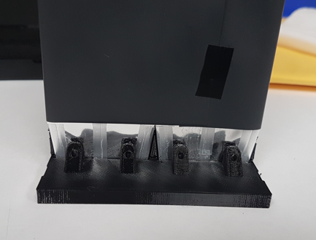
Cut Tedlar to cover the scintillator: A square of 7 by 7 inches will cover 2 side by side scintillators.
The Tedlar should cover all the scintillator, plus a part of the light-guide, but it shouldn’t cover all the light guide.

Slide 3
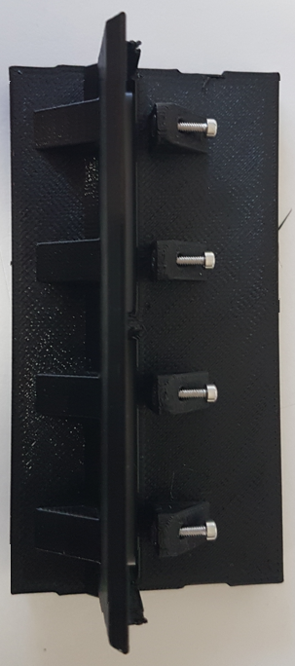
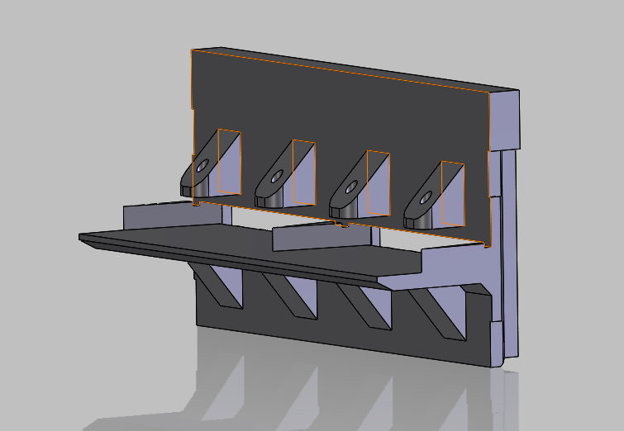
Pre-assembly of the holder
3D printed parts:
Hardware
18-8 Stainless Steel Socket Head Screw, M1.6 x 0.35 mm Thread, 8 mm Long (McMaster # 91292A264) -> QTY: 4
18-8 Stainless Steel Hex Nut, M1.6 x 0.35 mm Thread (McMaster # 91828A006) -> QTY: 4
Brass Tapered Heat-Set Inserts for Plastic, M2 x 0.4 mm Thread Size, 2.9 mm Installed Length (McMaster # 94180A307) -> QTY: 7
QTY: 1
screw
Insert nuts inside the holder, and secure-them with the screw.
nut
Insert the heat-set inserts in the 7 holes on the back. Use the tip of a solder iron to press the inserts.
Be sure that the inserts are flush with the holder -> use something flat to press on both the insert and the holder when you remove the solder iron, as the insert will sometimes spring back.

Slide 4
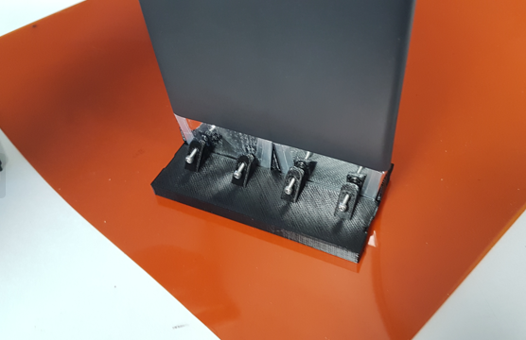
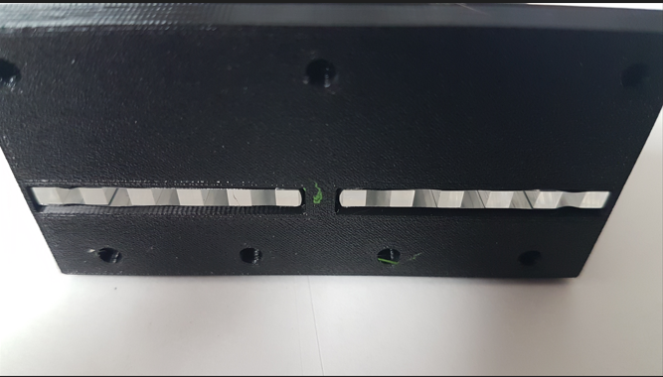
Mounting the scintillators on the holder
Insert the 2 wrapped scintillators into the pre-assembled holder.
Work on a flat and clean surface so the end of the light-guide is flush with the holder.

Slide 5
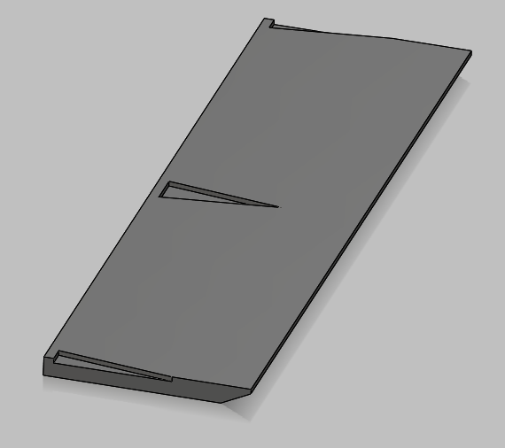
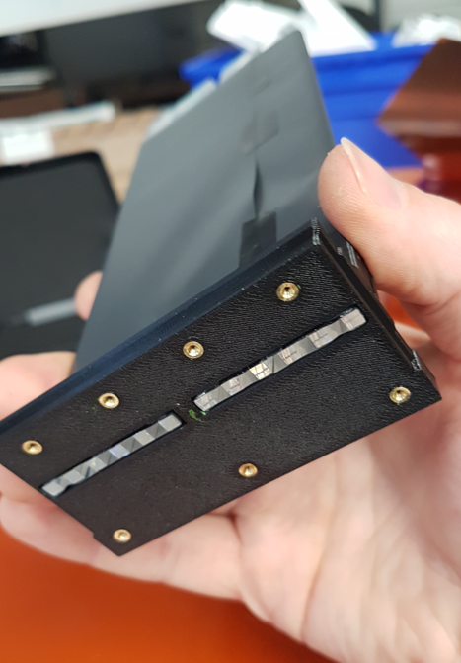
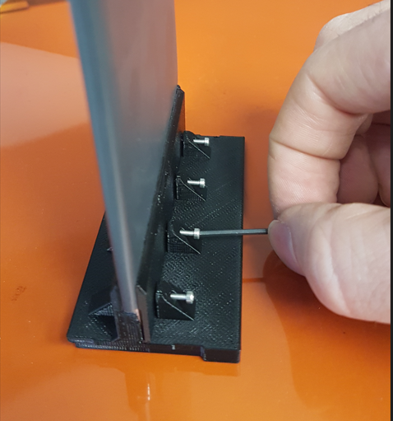
Insert the 3D printed cover between the brace and the scintillator.
The cover should sit flat.
Slightly tighten the screw: the idea is to introduce friction to prevent the scintillator to move.
But if you tighten the screws too much, the holder will bend.
-> Be sure the holder is still flat when you are done with this operation

Slide 6
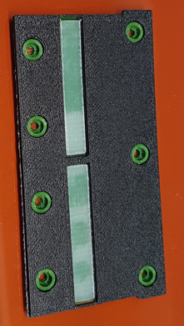
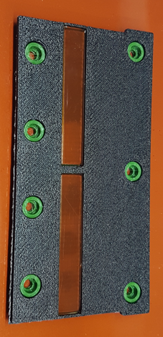
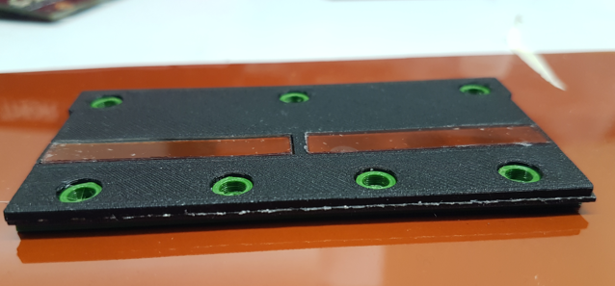
Molding the coupling against the light-guides
- Add the foam to the copper spacer
- Foam side up, place the copper spacer above the blue jig. Clean the rectangle apertures to remove any dust.
- add 1 rectangle of 0.13mm thick Kapton on each rectangle aperture. Be sure to clean both sides of the Kapton to remove dust and
grease (use isopropyl alcohol).
add 1 layer of pre-mold silicon coupling on each rectangle of kapton. Be sure to thoroughly clean each side of the silicon coupling with isopropyl alcohol and pay attention to not stick any dust or fiber.
Trim the cookie so it is just barely bigger than the set of SiPMs in both width and length. It will be smaller than the opening in the spacer. We do this so that the cookie doesn’t bend up and reduce our coupling strength.
CHANGE PICTURE

Slide 7
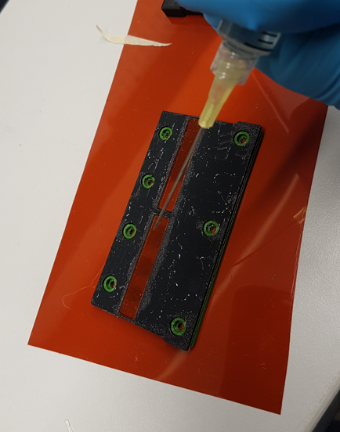
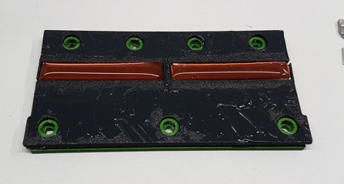
- Using a needle, add uncured silicon on the top of the pre-mold silicon coupling. Don’t put too much, just add a line in the center area.

Slide 8
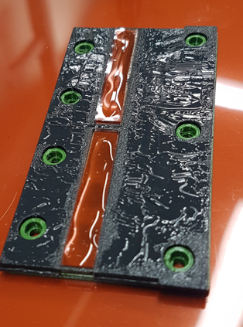
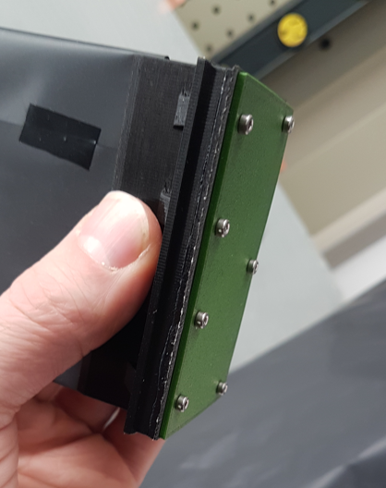
- Applied the scintillator+holder assembly on the top of the jig+spacer+silicon coupling.
Be sure it is well aligned before the contact of the 2 parts
You need to do-it in one time, if you miss-it, clean everything and restart.
Don’t rush, you have about 1h30 - 2hr before the silicon start to cure.
- When the 2 parts are on the top of each other, you can use M2x6mm screws to attach them together.
Try to keep the assembly as vertical as possible during this process.
Gently tighten the screw to squeeze the RTV. Don’t over tighten the screws.
Let-it cure vertically for about 8hr.

Slide 9
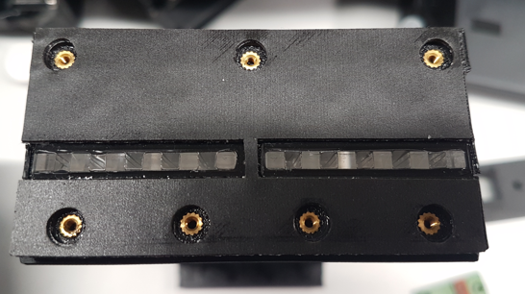
- When it is cured, remove the green jig and the Kapton rectangles, check if there are any bubbles,
and apply the adhesive foam on the exposed part of the spacer.
If you don’t want to seal the SiPM to the silicon coupling, you are done and can add the skin to the copper plate (between copper and the PCB) then press a PCB with SiPM against the foam.

